Slide 1

iQMatic@SML Scenario
Jonas Mårtensson, Pedro Lima, João Pedro Alvito, Rui Oliveira and Matteo Vanin

Slide 2
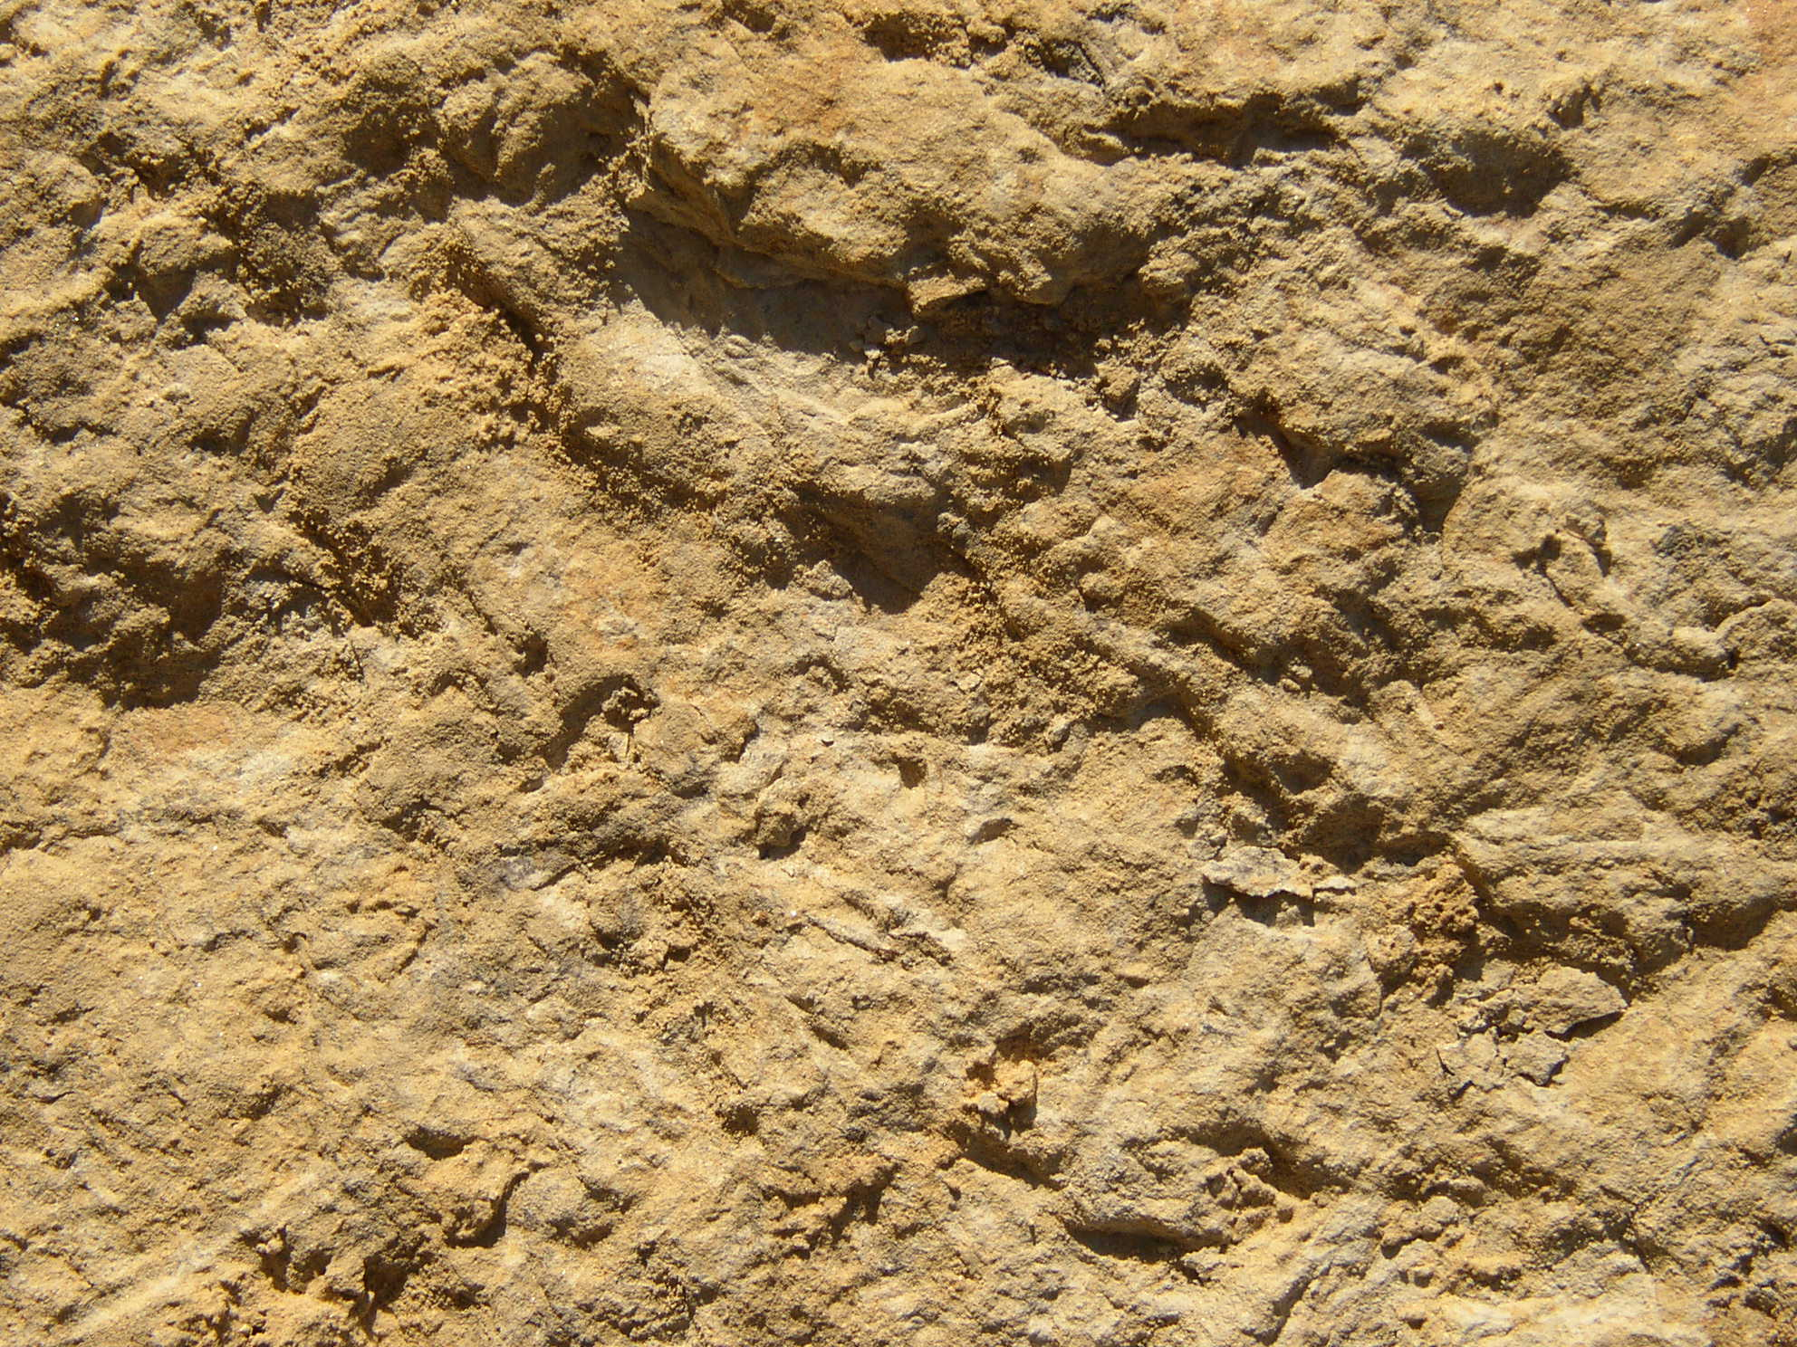
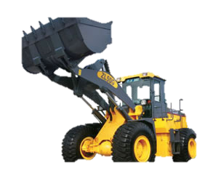
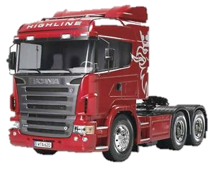

iQMatic@SML
The user is able to select the truck in the command central and give it a mission: to be loaded at the loading area and to unload in the unloading area. (the interesting waypoints 2. to 7. are sent to the truck).
The vehicle plans the path to the road and communicates back its status.
The vehicle follows the road until the intersection and communicates back its status.
5.
Loading area
6.
Unloading area
4.
2.
3.
1.,7.
Jonas Mårtensson, Pedro Lima, João Pedro Alvito, Rui Olveira and Matteo Vanin

Slide 3
iQMatic@SML
The vehicle reaches the open area and communicates back. The obstacles are static and known.
The truck plans the path in the open area in real time and follows it avoiding the obstacles. Then, communicates back the loading status.
The truck plans the path in the open area in real time and follows it avoiding the obstacles. Then, communicates back the unloading status.
The truck is able to return to the starting point and park.
5.
Loading area
6.
Unloading area
4.
2.
3.
1.,7.
Jonas Mårtensson, Pedro Lima, João Pedro Alvito, Rui Olveira and Matteo Vanin

